Slide 1
Ecommerce GloBAL SUPERSTORE

Slide 2
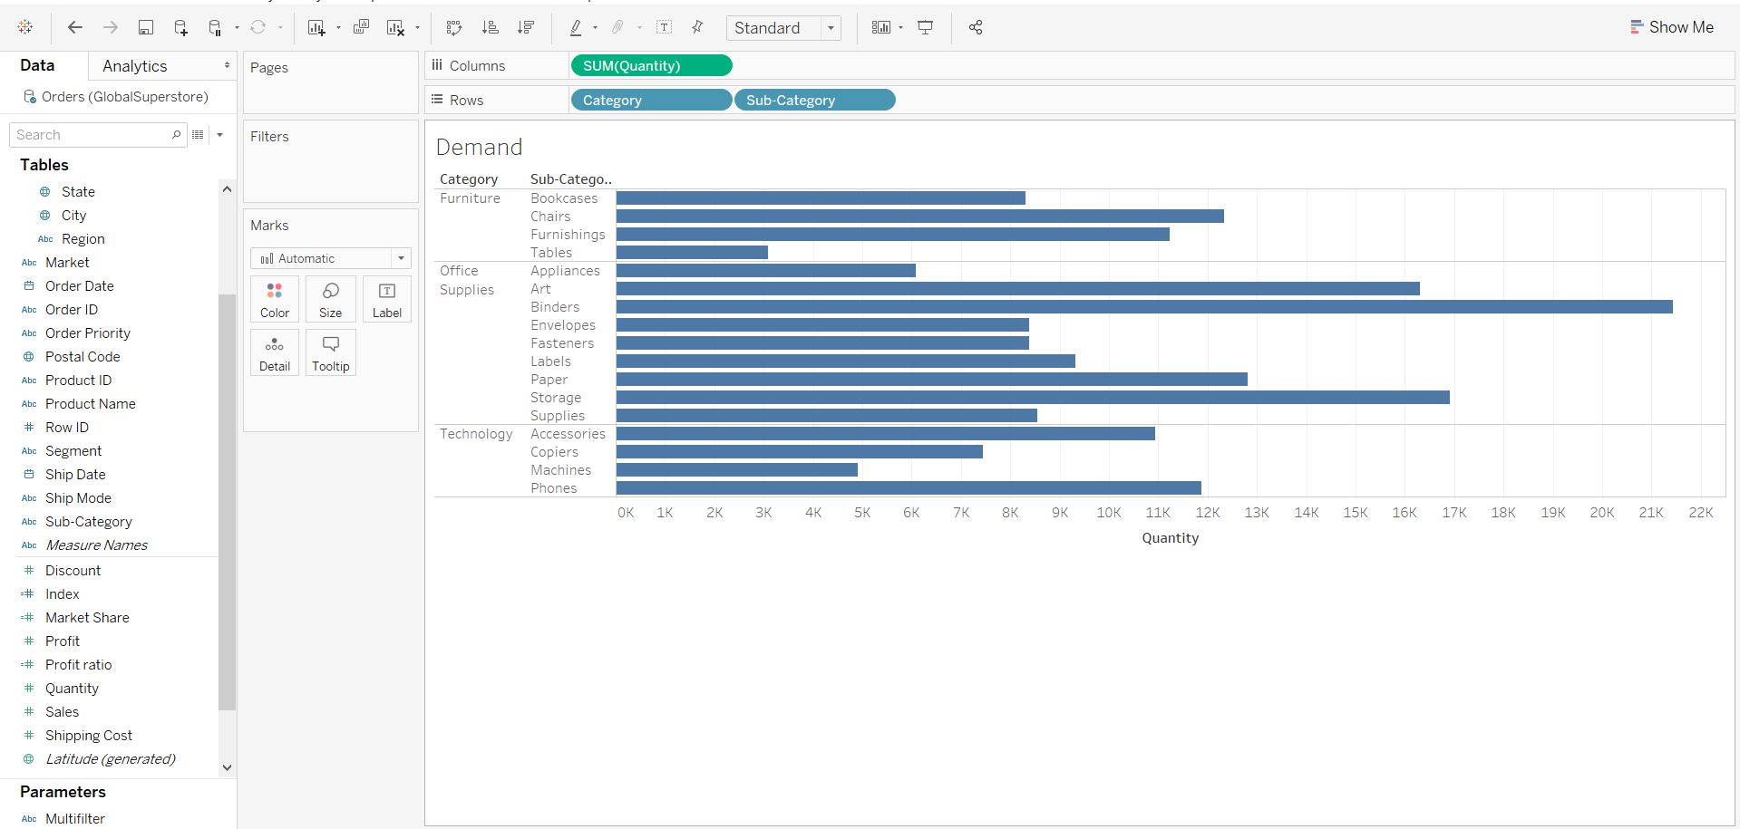
Demand In Quantity FOR Category and Sub-Category

Slide 3
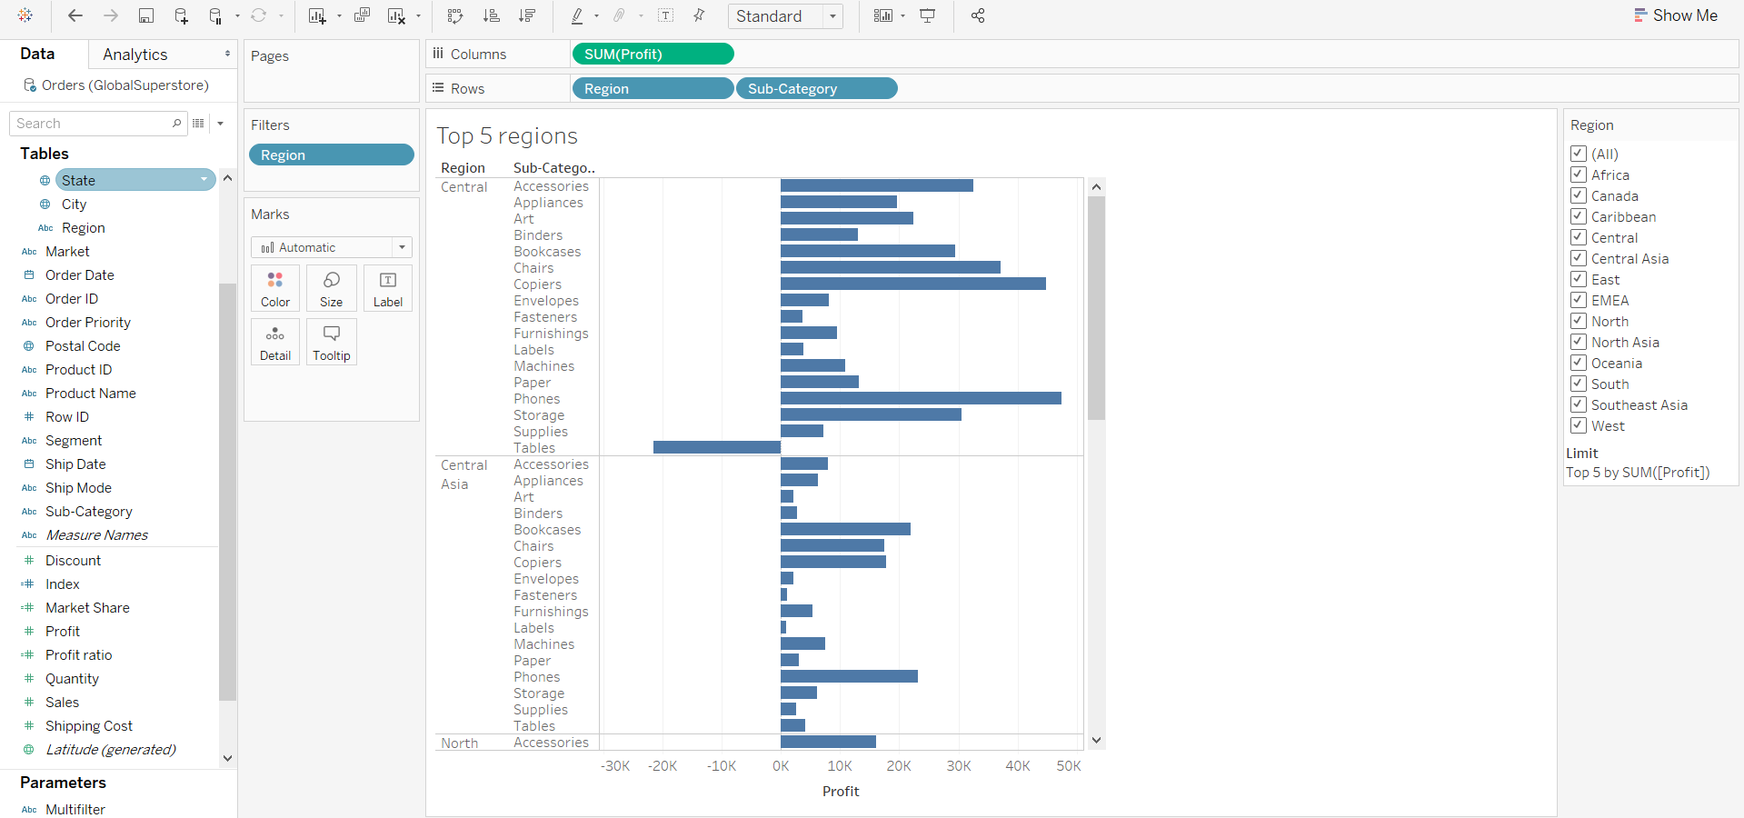
Top 5 Most ProFiTABLE REGIONS

Slide 4
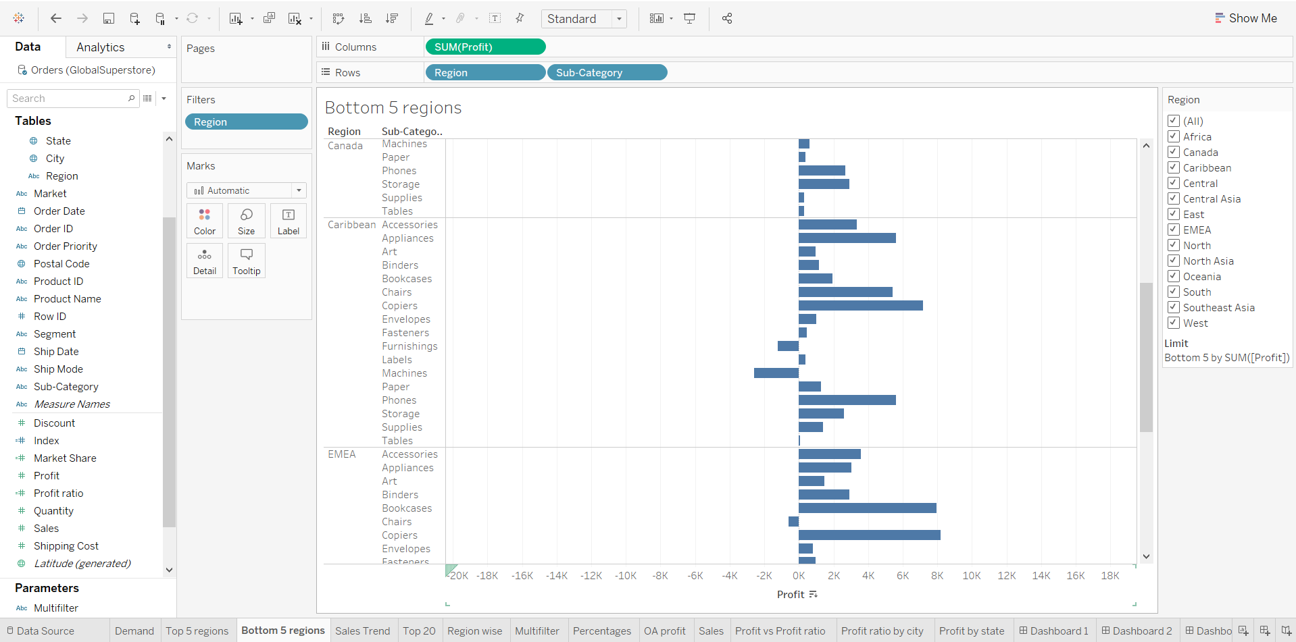
LEAST 5 Profitable Regions

Slide 5
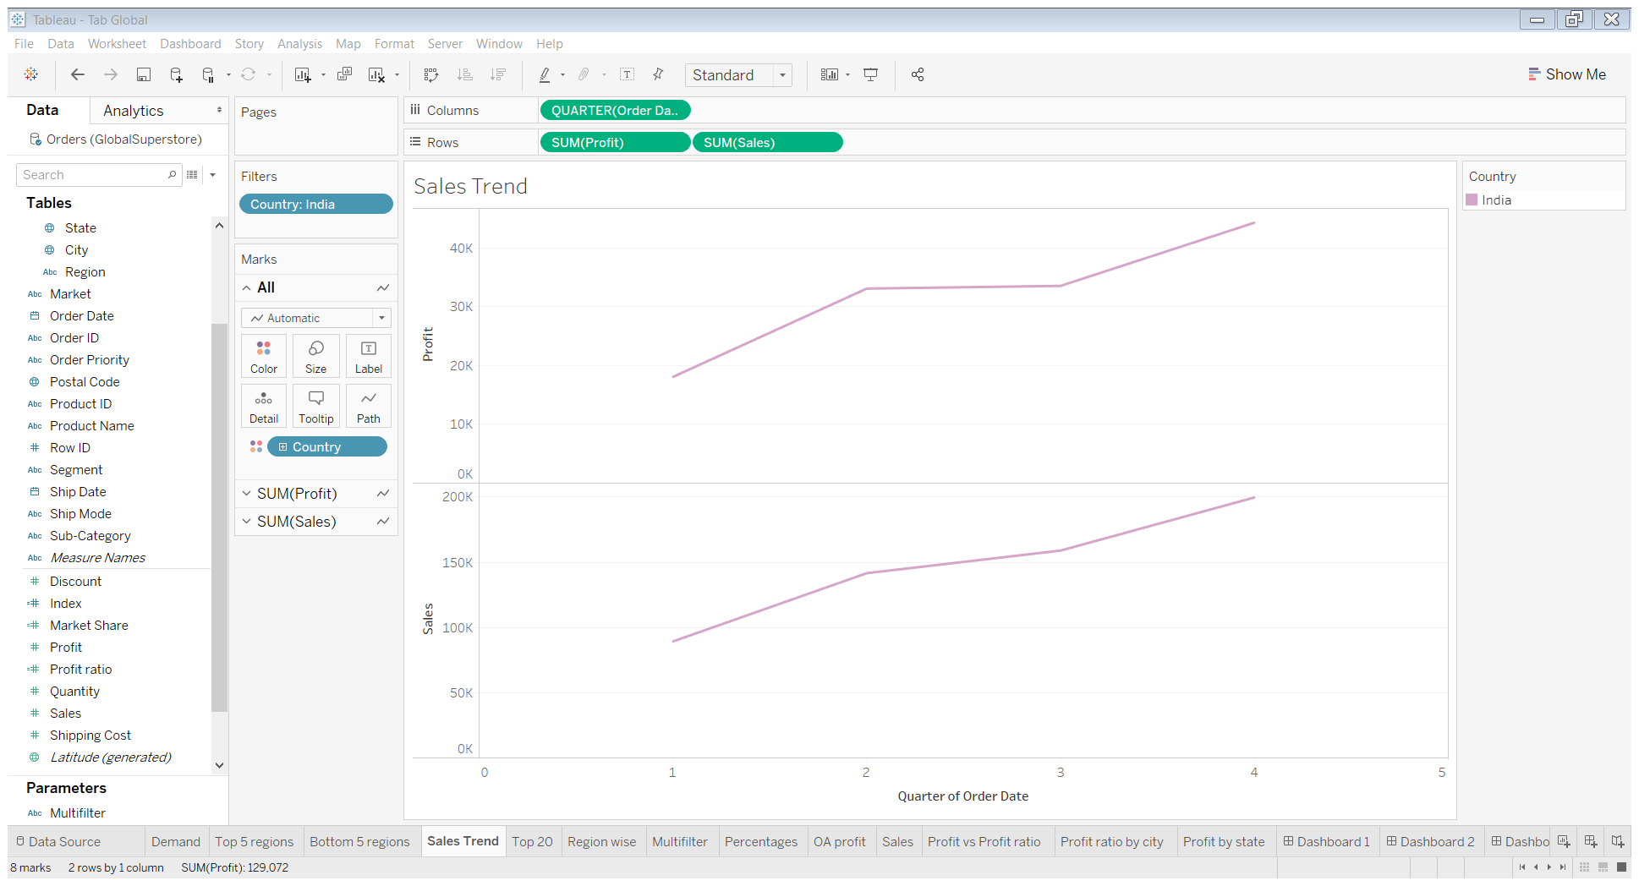
Sales TREND FOR Different Quarters

Slide 6
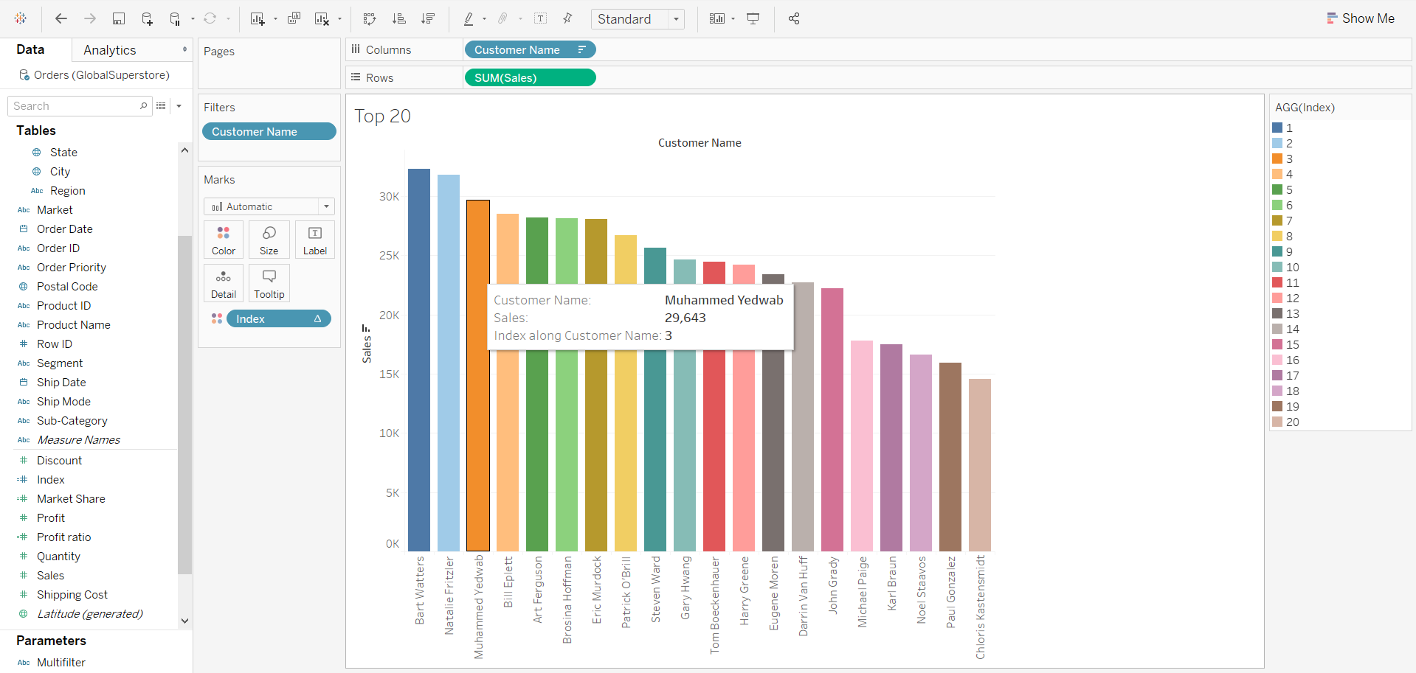
Top 20 CustomeRs Names Based on Sales

Slide 7
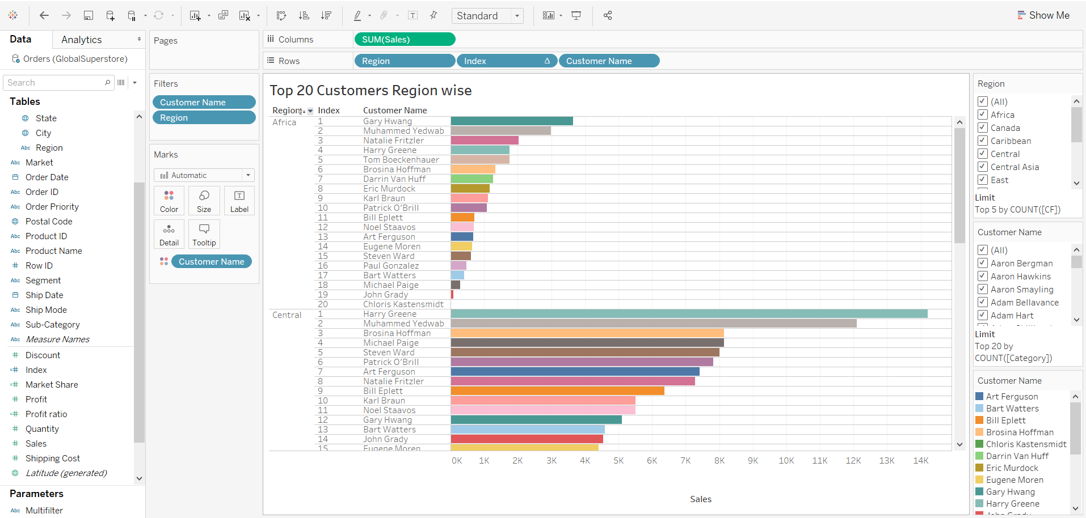
TOP 20 Customers region Wise

Slide 8
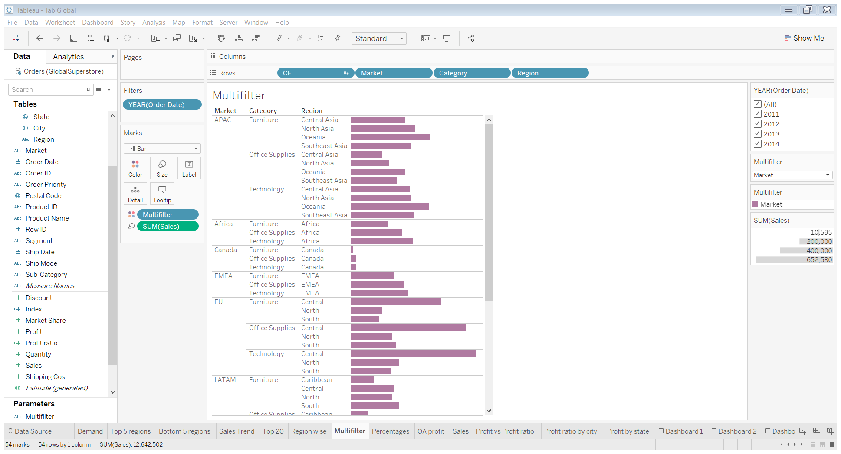
MULTIFILTER PARAMETER TO DISPLAY category, Region, Market Sales For all Years

Slide 9
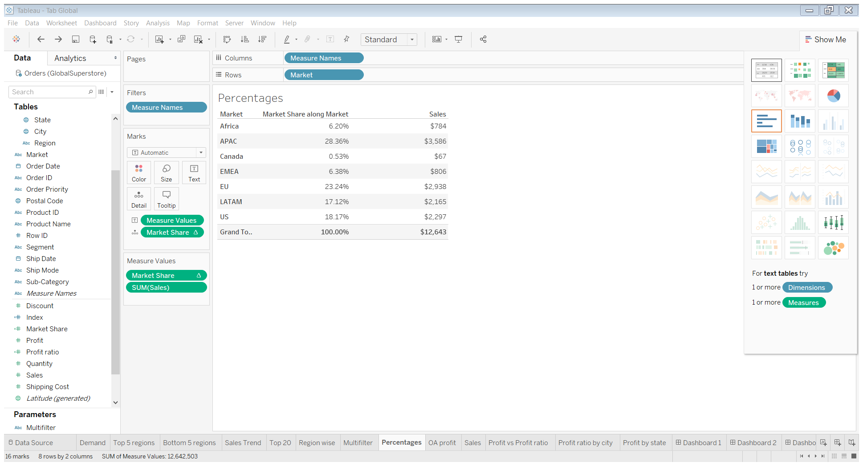
Converted overall sales to pedrcentages

Slide 10
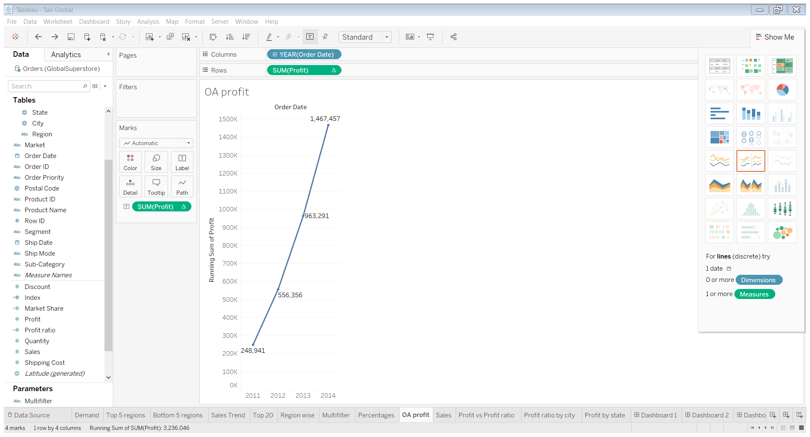
OVERALL PROFIT TILL DATE

Slide 11
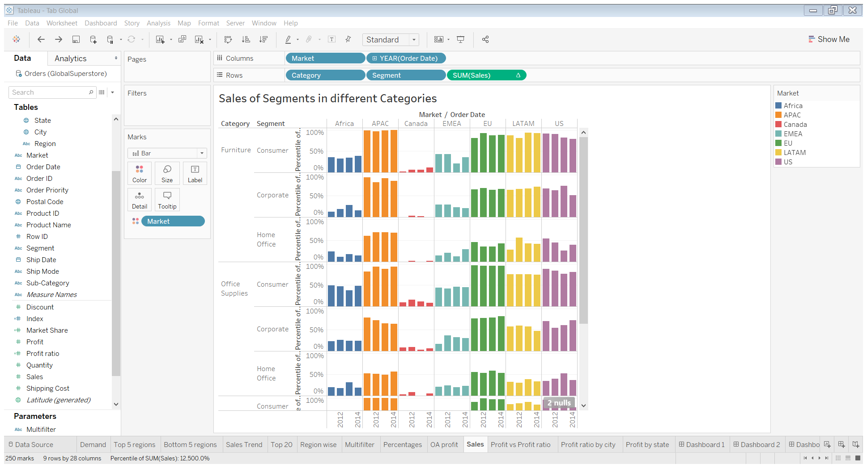
Sales of segments in Different categories

Slide 12
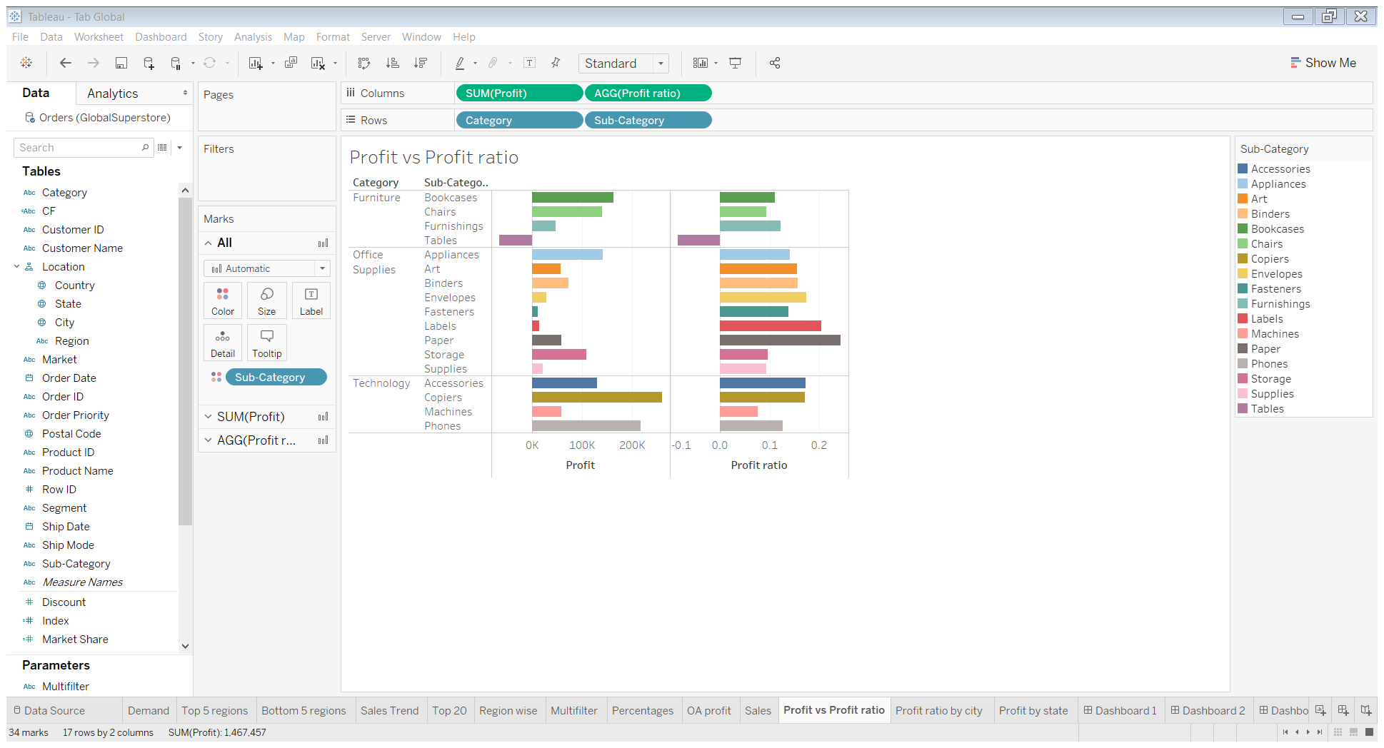
PROFIT VS PROFIT Ratio for different categories and sub-categories

Slide 13
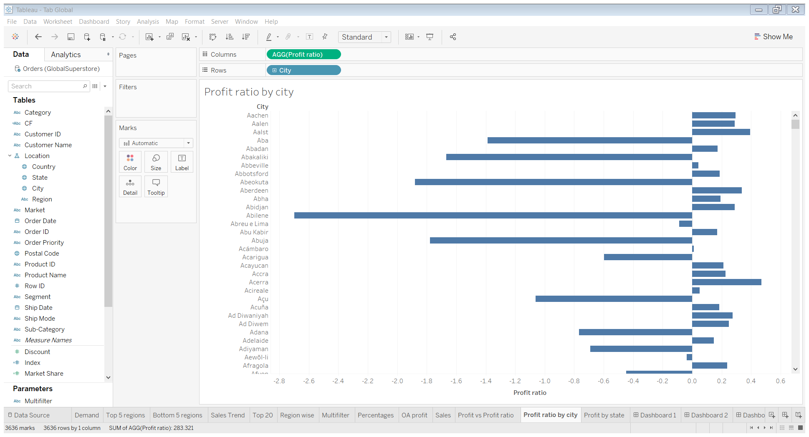
Profit Ratio by city

Slide 14
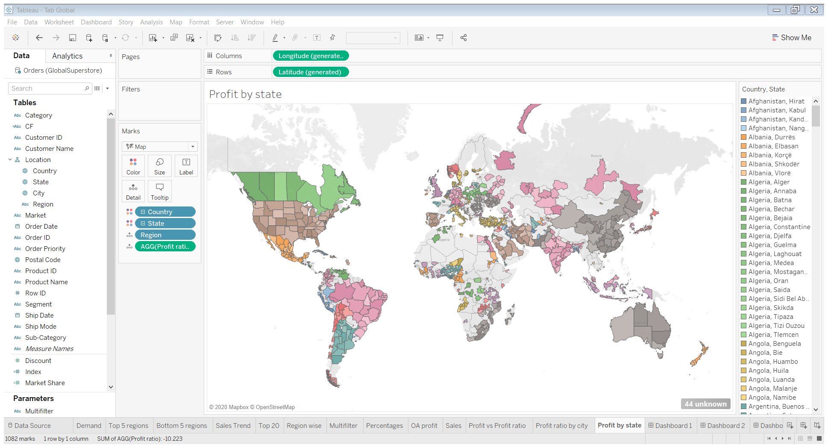
PROFIT RATIO For Each State

Slide 15
Summary
Created an efficient Tableau dashboard with all the necessary Business requirements with analysis on sales and profits at an overall level as well as at various dimensional cuts like Year over Year, Category, Sub-category, Market and Region. Advanced functions like Multifilter parameter, Conditional logics using Calculated fields were deployed to create a robust and dynamic dashboard.

